Slide 1
Introduction to YAXT
(Yet Another eXchange Tool, DKRZ 2012-2013)
Jörg Behrens, Moritz Hanke, Thomas Jahns

Slide 2
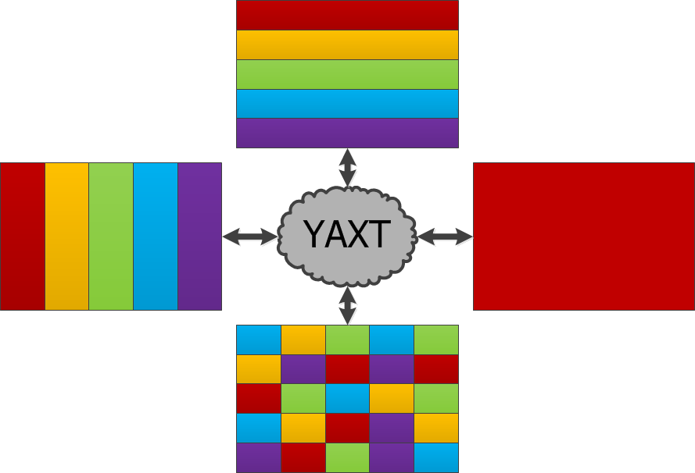
What it does
Redistribution of data between two sets of processes
Notes:
Each colour symbolizes a process holding some part of the data.
Comment on boundary exchange.

Slide 3
Some remarks
Library on top of MPI
Inspired by Fortran Prototype Unitrans by Mathias Pütz in ScalES-project
Implemented in C ⇒ type invariant
Fully-featured Fortran interface (requires C-interop)
Supported by DKRZ
BSD license
Git and SVN-readonly mirror repositories available
Uses pkg-config (pkg-config --cflags yaxt)
Notes:
Is installed on blizzard.

Slide 4
How it works
Initialisation
  Each process defines what data it has and what it wants (source and target decomposition).
  Generate a mapping between source and target decomposition.
  Generate data type specific redistribution object for a given mapping.
Timeloop
  Do the exchange
Finalisation
  Clean up

Slide 5
Defining a decomposition
Assumptions:
  All data elements have the same memory layout and are stored in an array (C makes no difference between 1D and nD-arrays)
  Each data object has a unique global id (integer).
A decomposition is a list of global data element ids.
The positions of the global ids within the set correspond to the positions of the respective data elements within the data array (if nothing else is said).
Notes:
Array-Layout can be faked, we really only need properly aligned elements.
Give simple example on white-board.

Slide 6
Generate mapping between src and tgt decomposition
To generate a mapping you need to provide the two decompositions and a MPI communicator.
The operation is collective for all processes within the given communicator.

Slide 7
Generate data specific redistribution object
To generate a data specific redistribution object the user needs to provide a mapping object and the MPI data type for the data elements.
It is possible to combine multiple existing redistribution objects (useful for aggregation of data exchanges).

Slide 8
Doing the exchange and clean up
To do the exchange the user needs to call the exchange routine and provide a redistribution object and the source and target array(s) (passed via C_LOC from Fortran).
All objects generated by YAXT can be destroyed by calling the respective destructor.

Slide 9

Example 1
Gather on rank 0

Slide 10
Defining a decomposition.
int src_index = rank;
Xt_idxlist src_idxlist =
xt_idxvec_new(&src_index, 1);
Xt_idxlist tgt_idxlist;
if (rank == 0) {
struct Xt_stripe tgt_stripe =
{.start = 0, .nstrides = 4, .stride = 1};
tgt_idxlist =
xt_idxstripes_new(&tgt_stripe, 1);
} else
tgt_idxlist = xt_idxempty_new();
Notes:
Note: source only uses single index!

Slide 11
Generate mapping between src and tgt decomposition.
Xt_xmap xmap =
xt_xmap_all2all_new(
src_idxlist, tgt_idxlist,
MPI_COMM_WORLD);

Slide 12
Generate data specific redistribution object.
Xt_redist redist =
xt_redist_p2p_new(xmap, MPI_INT);

Slide 13
Doing the exchange and clean up.
int src_data[1] = {…};
int tgt_data[4];
xt_redist_s_exchange1(
redist, src_data, tgt_data);
xt_redist_delete(redist);
xt_xmap_delete(xmap);
xt_idxlist_delete(tgt_idxlist);
xt_idxlist_delete(src_idxlist);

Slide 14
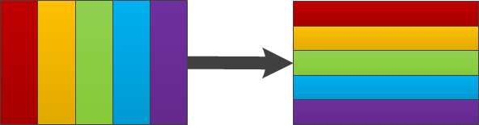
Example 2
Transpose from row-wise to column-wise decomposition
Example program: examples/row2col_f.f90

Slide 15
Create idxlist for row-wise decomposition
row_part_range(1, 1) = &
INT(uniform_partition_start(global_range(:, 1), &
comm_size, rank + 1))
row_part_range(2, 1) = &
INT(uniform_partition_start(global_range(:, 1), &
comm_size, rank + 2)) - 1
row_part_range(:, 2) = INT(global_range(:, 2))
row_part_shape(:) = row_part_range(2, :) – &
row_part_range(1, :) + 1

Slide 16
Create idxlist for column-wise decomposition
col_part_range(:, 1) = INT(global_range(:, 1))
col_part_range(1, 2) = &
INT(uniform_partition_start(global_range(:, 2), &
comm_size, rank + 1))
col_part_range(2, 2) = &
INT(uniform_partition_start(global_range(:, 2), &
comm_size, rank + 2)) – 1
col_part_shape(:) = col_part_range(2, :) &
- col_part_range(1, :) + 1

Slide 17
example for 10x5 global shape and 2nd (= MPI rank 1) of 3 processes
global_range(1:2, 1:2) = RESHAPE((/ 1, 10, 1, 5, &
(/ 2, 2 /))
row_part_range(1, 1) = 4
row_part_range(2, 1) = 7
row_part_range(:, 2) = (/ 1, 5 /)
row_part_shape(:) = (/ 4, 5 /)
col_part_range(:, 1) = (/ 1, 10 /)
col_part_range(1, 2) = 2
col_part_range(2, 2) = 3
col_part_shape(:) = (/ 10, 2 /)

Slide 18
Create decomposition descriptors
src_idxlist = xt_idxfsection_new(0_xt_int_kind, &
INT(global_shape, xt_int_kind), &
INT(row_part_shape, xt_int_kind), &
INT(row_part_range(1, :), xt_int_kind))
tgt_idxlist = xt_idxfsection_new(0_xt_int_kind, &
INT(global_shape, xt_int_kind), &
INT(col_part_shape, xt_int_kind), &
INT(col_part_range(1, :), xt_int_kind))

Slide 19
Create mapping and redistribution
! generate exchange map
xmap = xt_xmap_all2all_new(src_idxlist, tgt_idxlist, &
mpi_comm_world)
! generate redistribution object
redist = xt_redist_p2p_new(xmap, mpi_double_precision)

Slide 20
Fill source array and redistribute
! prepare arrays
ALLOCATE(src_array(row_part_range(1, 1):row_part_range(2, 1), &
& row_part_range(1, 2):row_part_range(2, 2)), &
& tgt_array(col_part_range(1, 1):col_part_range(2, 1), &
& col_part_range(1, 2):col_part_range(2, 2)))
DO j = row_part_range(1, 2), row_part_range(2, 2)
DO i = row_part_range(1, 1), row_part_range(2, 1)
src_array(i, j) = DBLE(i * j)
END DO
END DO
! do the exchange
CALL xt_redist_s_exchange1(redist, C_LOC(src_array), C_LOC(tgt_array))

Slide 21
Finish up
! clean up
DEALLOCATE(tgt_array, src_array)
CALL xt_redist_delete(redist)
CALL xt_xmap_delete(xmap)
CALL xt_idxlist_delete(tgt_idxlist)
CALL xt_idxlist_delete(src_idxlist)
! finalise
CALL xt_finalize()
CALL mpi_finalize(ierror)
IF (ierror /= mpi_success) STOP 1

Slide 22
Methods to define a decomposition
Index lists (Xt_idxlist) describe subsets of indices within the global index space
The global index space can be any list of indices
There are multiple methods for constructing index lists:
  Index vector
  Index stripes
  Index section
  Index list collection
  Index modifier
  Empty Index list

Slide 23
Methods to define a decomposition
Index vector
  Arbitrary list of indices:
    [0,3,32,26,44,14,48]
Index stripes
  List of stripes:
  [[start = 0, nstrides = 3, stride = 2], [start = 1, nstrides = 2,
  stride = 2]] == [0,2,4,1,3]
Index section
  N-dimensional block of indices
  [start = 0, num_dimension = 2, global_size = [5,5],
  local_size = [3,3], local_start = [1,1]] == [6,7,8,11,12,13,16,17,18]

Slide 24
Methods to define a decomposition
Index list collection
  Combination of a number of index lists
Index modifier
  The modifier allows to define a mapping between indices
  Modifiers create a new index list from an existing index list
  Index list: I =[0,1,2,3,4,5]
  Modifier: M = [0,2,4,6,8,10]->[10,8,6,4,2,0]
  M(I)=[10,1,8,3,6,5]
Empty index list
  …
Notes:
Modifiers are defined using Index-lists → should be described in a compact way

Slide 25
Generate mapping between src and tgt decomposition
Exchange maps (Xt_xmap) determine communication partners and what data needs to be exchanged, based on the decomposition
Algorithms
  Every process sends its src and tgt list to all other processes
  Rendezvous algorithm[1] based on a distributed directory of global indices is used to avoid all to all communication patterns
[1] A. Pinar and B. Hendrickson, Communication Support for Adaptive Computation} in Proc. SIAM Conf. on Parallel Processing for Scientific Computing, 2001.

Slide 26
Generate data specific redistribution object
Redistribution objects (Xt_redist) can be built for every non-null MPI data type (basic types, structs, vectors, …)
Internally YAXT will build MPI data type for every required exchange → no buffers are required for the exchange
For a combined redistribution object YAXT will also build MPI data types even if the associated input arrays have no fixed offset between each other
Notes:
Non-fixed offsets occur with dynamic arrays.

Slide 27
Doing the exchange
YAXT currently supports blocking redistribution of data.

Slide 28
Real world example:
ECHAM(gp ←→ ffsl): gp-decomposition
TYPE(xt_idxlist) FUNCTION new_gp_3d_idxvec()
INTEGER :: idx(gp_3d_vol)
INTEGER :: i, j, k, p, r, index, n
n = SIZE(idx)
p = 0
DO k = 1, nlev
DO r = 1, 2
DO j = glats(r), glate(r)
DO i = glons(r), glone(r)
index = i + nlon * ( (j-1) + nlat * (k-1) )
p = p + 1
idx(p) = index
ENDDO !i
ENDDO !j
ENDDO !r
ENDDO !k
new_gp_3d_idxvec = xt_idxvec_new(idx, n)
END FUNCTION new_gp_3d_idxvec

Slide 29
ECHAM(gp ←→ ffsl): ffsl-decomposition
TYPE(xt_idxlist) FUNCTION new_ffsl_3d_idxvec()
INTEGER :: idx(ffsl_3d_vol)
INTEGER :: i, j, k, kk, p, index, n
n = size(idx)
p = 0
DO kk = 1, ffsl_nlev
k = ffsl_kstack(kk)
DO j = ffsl_gp_lat1, ffsl_gp_lat2
DO i = 1, nlon
p = p + 1
index = i + nlon * ( (j-1) + nlat * (k-1) )
idx(p) = index
ENDDO
ENDDO
ENDDO
new_ffsl_3d_idxvec = xt_idxvec_new(idx, n)
END FUNCTION new_ffsl_3d_idxvec

Slide 30
ECHAM(gp ←→ ffsl): gp-offsets
SUBROUTINE set_gp_3d_off(off)
INTEGER, INTENT(out) :: off(:)
INTEGER :: coords_off(nproma, nlev, ngpblks)
INTEGER :: i, j, k, p, r, ib, ia, index, n
n = SIZE(off)
p = 0
DO ib = 1, ngpblks
DO k = 1, nlev
DO ia = 1, nproma
coords_off(ia,k,ib) = p
p = p + 1
ENDDO
ENDDO
ENDDO
p = 0
DO k = 1, nlev
ib = 1
ia = 0
DO r = 1, 2
DO j = glats(r), glate(r)
DO i = glons(r), glone(r)
p = p + 1
ia = ia +1
IF (ia > nproma) THEN
ib = ib + 1
ia = 1
ENDIF
off(p) = coords_off(ia,k,ib)
ENDDO !i
ENDDO !j
ENDDO !r
ENDDO !k
END SUBROUTINE set_gp_3d_off
Local offsets
Global index space
Index to offset relation:
p-th local index corresponds to p-th local offset,
(i,j,k) → p → (ia,k,ib)

Slide 31
ECHAM(gp ←→ ffsl): ffsl-offsets
SUBROUTINE set_ffsl_3d_off(off)
INTEGER, INTENT(out) :: off(:)
INTEGER :: coords_off(nlon, ffsl_nlat, ffsl_nlev)
INTEGER :: i, j, k, kk, ic, jc, kc, p, index, n
n = SIZE(off)
p = 0
DO kc = 1, ffsl_nlev
DO jc = ffsl_nlat, 1, -1 ! change in j-orientation
DO ic = 1, nlon
coords_off(ic, jc, kc) = p
p = p + 1
ENDDO
ENDDO
ENDDO
p = 0
DO kk = 1, ffsl_nlev
kc = kk
DO j = ffsl_gp_lat1, ffsl_gp_lat2
jc = j-ffsl_gp_lat1+1
DO i = 1, nlon
ic = i
p = p + 1
off(p) = coords_off(ic, jc, kc)
ENDDO
ENDDO
ENDDO
END SUBROUTINE set_ffsl_3d_off

Slide 32
ECHAM(gp ←→ ffsl): usage
! Definitions:
USE yaxt
TYPE(xt_idxlist) :: gp_3d_idxlist, ffsl_3d_idxlist
TYPE(xt_xmap) :: gp2ffsl_3d_xmap
INTEGER, ALLOCATABLE :: gp_3d_off(:), ffsl_3d_off(:)
TYPE(xt_redist), SAVE :: gp2ffsl_3d_redist
! Decompositions:
gp_3d_idxlist = new_gp_3d_idxvec()
ffsl_3d_idxlist = new_ffsl_3d_idxstripes()
! Init xmap:
gp2ffsl_3d_xmap = xt_xmap_all2all_new(gp_3d_idxlist, ffsl_3d_idxlist, model_comm)
! Offsets:
CALL set_gp_3d_off(gp_3d_off)
CALL set_ffsl_3d_off(ffsl_3d_off)
! Redist:
gp2ffsl_3d_redist = xt_redist_p2p_off_new(gp2ffsl_3d_xmap, gp_3d_off, ffsl_3d_off, p_real_dp)
! Usage in the model:
CALL xt_redist_s_exchange1(gp2ffsl_3d_redist, C_LOC(gp_data), C_LOC(ffsl_data))

Slide 33
Real world example:
MPIOM bounds-exchange with modifiers
! Different exchange kinds, each of them
! behaves differently at global domain boundaries
INTEGER, PARAMETER :: p_exch_kind = 1
INTEGER, PARAMETER :: uplus_exch_kind = 2
INTEGER, PARAMETER :: u_exch_kind = 3
INTEGER, PARAMETER :: uu_exch_kind = 4
INTEGER, PARAMETER :: vplus_exch_kind = 5
INTEGER, PARAMETER :: v_exch_kind = 6
INTEGER, PARAMETER :: vv_exch_kind = 7
INTEGER, PARAMETER :: vf_exch_kind = 8
INTEGER, PARAMETER :: s_exch_kind = 9
INTEGER, PARAMETER :: sminus_exch_kind = 10
! Usage of yaxt-modifiers to simplify definitions of
! Decompositions

Slide 34
Simplified incomplete bounds-exchange example
Global source decomposition
Global target decomposition
1 | 2 | 3 | 4 | 5 | 6
7 | 8 | 9 | 10 | 11 | 12
13 | 14 | 15 | 16 | 17 | 18
19 | 20 | 21 | 22 | 23 | 24
5 | 2 | 3 | 4 | 5 | 2
11 | 8 | 9 | 10 | 11 | 8
17 | 14 | 15 | 16 | 17 | 14
23 | 20 | 21 | 22 | 23 | 20
Modifier M:
M₁ = [1,7,13,19]→[5,11,17,23] M₂ = [6,12,18,24]→[2,8,14,20]
M(I) = M₂(M₁(I))
Local source indices (including halos):
I_{s} = [15,16,17,18,21,22,23,24]
Local target indices (including halos):
I_{t} = M(I_{s}) = [15,16,17,14,21,22,23,20]
Modifier can be applied to any index subset
Not included here:
Exchange of inner halos

Slide 35
Completing the bounds-exchange example
Global domain halos:
- described by modifiers
M_{i} : Source_{i} Target_{i}
Local sub-domain halos:
Depend on stencil extents
Local border definition done by user-code

Slide 36
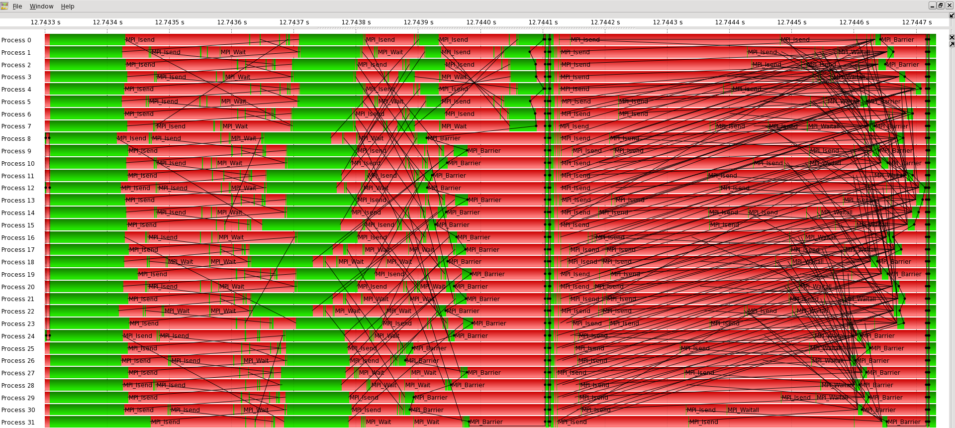
MPIOM 3d-bounds-exchange measurement
Handwritten – requires symmetric regular decomposition
UniTrans/YAXT general solution

Slide 37
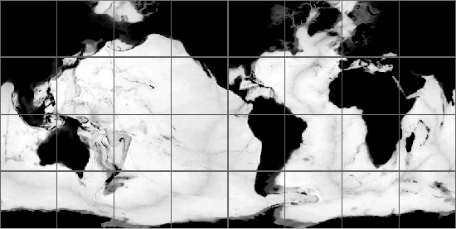

MPIOM [TP04L40: 8x4] Load Balance
Wet-point-only optimized
Workload changed
Unfit legacy decomposition
Nothing gained
Adapted decomposition
Old boundary exchange fails
Reprogramming exchange?
YAXT-formulation:
  works for both cases
  faster

Slide 38
Future plans
Support asynchronous redistributions
In-Place redistributions
Multi-Phase exchanges
Use YAXT in MPIOM, ECHAM, ICON and CDI-PIO

Slide 39
Questions?
Documentation:
https://redmine.dkrz.de/doc/yaxt/html/index.html
Redmine:
https://www.dkrz.de/redmine/projects/yaxt
Download:
https://www.dkrz.de/redmine/projects/yaxt/wiki/Downloads

